Slide 1






Eyewitness Identification Procedures
Simultaneous Lineup
Suspect:
Innocent or Guilty?
Fillers:
All are known to be innocent

Slide 2
Eyewitness Identification Procedures
Simultaneous Lineup
Sequential Lineup
Suspect:
Innocent or Guilty?

Slide 3
Lindsay & Wells (1985)
Simultaneous lineup
  Correct ID rate = 0.58
  False ID rate = 0.43
Sequential lineup
  Correct ID rate = 0.50
  False ID rate = 0.17
.58 / .43 = 1.35
Diagnosticity Ratio
.50 / .17 = 2.94

Slide 4
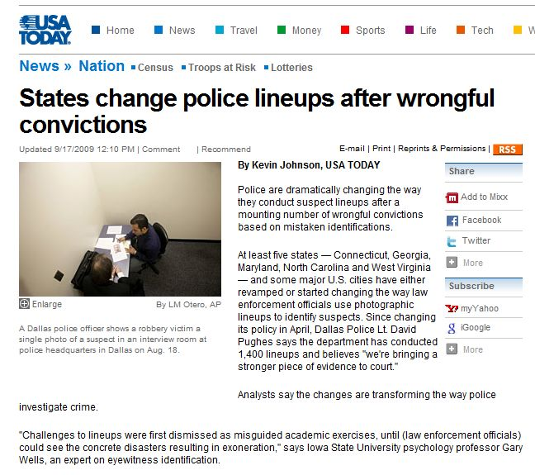

Slide 5
Lindsay & Wells (1985)
Simultaneous lineup
  Correct ID rate = 0.58
  False ID rate = 0.43
Sequential lineup
  Correct ID rate = 0.50
  False ID rate = 0.17

Slide 6
Lindsay & Wells (1985)
Simultaneous lineup
  Correct ID rate = 0.58
  False ID rate = 0.43
Sequential lineup
  Correct ID rate = 0.50
  False ID rate = 0.17

Slide 7
The Concept of Response Bias
Do not make an ID if you are just guessing
Do not make an ID unless you are reasonably sure
Do not make an ID unless you are very sure
Do not make an ID unless you are absolutely certain

Slide 8
The Concept of Response Bias
Simultaneous lineup
  Correct ID rate = 0.58
  False ID rate = 0.43
Sequential lineup
  Correct ID rate = 0.50
  False ID rate = 0.17
2.94
2.28
1.81
1.35
3.90
4.40

Slide 9
Lindsay & Wells (1985)
Relative decision strategy
Simultaneous lineup
  Correct ID rate = 0.58
  False ID rate = 0.43
Sequential lineup
  Correct ID rate = 0.50
  False ID rate = 0.17
2.28
1.81
1.35
3.9
4.40
Absolute decision strategy

Slide 10
The Concept of Discriminability
Simultaneous lineup
  Correct ID rate = 0.58
  False ID rate = 0.43
Sequential lineup
  Correct ID rate = 0.50
  False ID rate = 0.17

Slide 11
The Concept of Discriminability
A higher ROC is objectively superior to a lower ROC
Simultaneous lineup
  Correct ID rate = 0.58
  False ID rate = 0.43
Sequential lineup
  Correct ID rate = 0.50
  False ID rate = 0.17

Slide 12
Lindsay & Wells (1985)
Simultaneous lineup
  Correct ID rate = 0.58
  False ID rate = 0.43
Sequential lineup
  Correct ID rate = 0.50
  False ID rate = 0.17

Slide 13
The Concept of Discriminability
A higher ROC is objectively superior to a lower ROC
Simultaneous lineup
  Correct ID rate = 0.58
  False ID rate = 0.43
Sequential lineup
  Correct ID rate = 0.50
  False ID rate = 0.17

Slide 14
Results from ROC Analysis
Simultaneous vs. Sequential
Mickes, L., Flowe, H. D., & Wixted, J. T. (2012). Journal of Experimental Psychology: Applied, 18, 361–376.

Slide 15


Slide 16
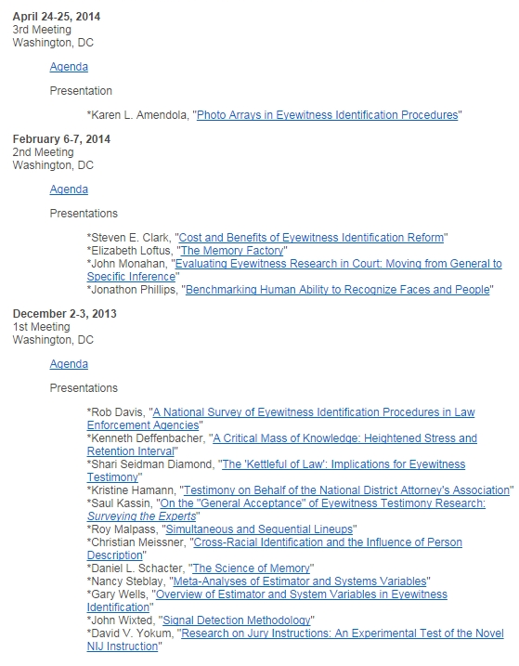
Meetings

Slide 17
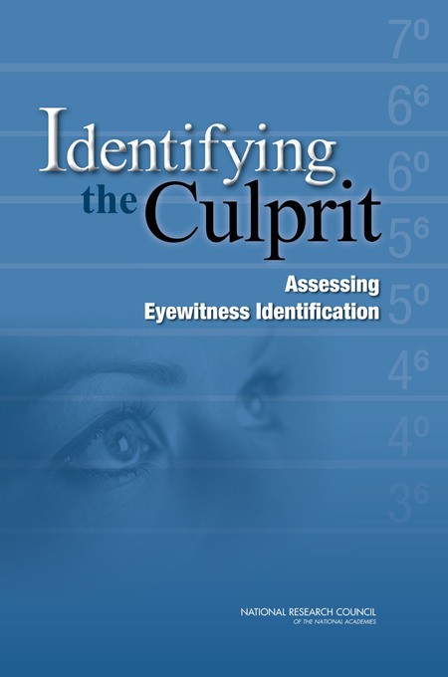

Slide 18
My take: “NAS Report Slams Breaks on Decades-Long Push for Sequential Lineups”
“In view of these considerations of performance criteria and recommendations about analysis tools, can we draw definitive conclusions about which lineup procedure (sequential or simultaneous) is preferable? At this point, the answer is no.”
"It is important to recognize, however, that, in certain cases, the state of scientific research on eyewitness identification is unsettled. For example, the relative superiority of competing identification procedures (i.e., simultaneous versus sequential lineups) is unresolved."
“The committee recommends that caution and care be used when considering changes to any existing lineup procedure, until such time as there is clear evidence for the advantages of doing so.”

Slide 19
Diagnosticity Ratio or ROC Analysis?
“Despite its merits, a single diagnosticity ratio thus conflates the influences of discriminability and response bias on binary classification, which muddies the determination of which procedure, if any, yields objectively better discriminability in eyewitness performance.”
“Perhaps the greatest practical benefit of recent debate over the utility of different lineup procedures is that it has opened the door to a broader consideration of methods for evaluating and enhancing eyewitness identification performance. ROC analysis is a positive and promising step, with numerous advantages.”
“The committee concludes that there should be no debate about the value of greater discriminability – to promote a lineup procedure that brings less discriminability would be akin to advocating that the lineup be performed in dim instead of bright light.”

Slide 20
What About Recent Review Articles Promoting the “Sequential Superiority Effect?”
The most recent review is Steblay, Dysart & Wells (2011)
“However, none of the reviews met all current standards for conducting and reporting systematic reviews, and few met even a majority of these standards, making assessment of the credibility of their findings problematic. After examining the reviews, the committee concluded that the findings may be subject to unintended biases and the conclusions are less credible than was hoped.”

Slide 21
What About Recent ROC Analyses?
“…a small set of recent studies using ROC analysis has reported that discriminability (area under the ROC curve) for simultaneous lineups is as high, or higher, than that for sequential lineups.”
“Amendola and Wixted re-analyzed a subset of the data for which proxy measures of ground truth were available…Their analyses suggested that identification of innocent suspects is less likely and identification of guilty suspects is more likely when using the simultaneous procedures. While future studies are needed, these latter findings raise the possibility that diagnosticity is higher for the simultaneous procedures.”

Slide 22
The American Judicature Society (AJS) Field Study
Real eyewitnesses were randomly assigned to simultaneous or sequential lineups in 4 sites:
  Austin
  San Diego
  Tucson
  Charlotte-Mecklenburg County
A 2-phase investigation
  Phase 1: Wells et al. (2014) measured frequency of suspect and filler IDs
  Phase 2: Amendola & Wixted (2014) measured ground truth guilt of identified suspects

Slide 23
Phase 1 Results
Wells et al. (2014, Law & Human Behavior)
Simultaneous Lineup
Suspect:
Innocent or Guilty?

Slide 24
Phase 1 Results
Wells et al. (2014, Law & Human Behavior)
Sequential
Simultaneous
 | Frequency | Proportion
suspect | 65 | 0.275
filler | 29 | 0.123
non-ID | 142 | 0.602
sum | 236 | 1.00
 | Frequency | Proportion
suspect | 67 | 0.260
filler | 46 | 0.178
non-ID | 145 | 0.562
sum | 258 | 1.00
χ²(2) = 2.94, p = .23

Slide 25
SIM
50 + 17 = 67 suspects identified
SEQ
47 + 20 = 67 suspects identified
.50
.47
.17
.20
SIM: 50 / 67 = .75 are guilty
SEQ: 47 / 67 = .70 are guilty

Slide 26
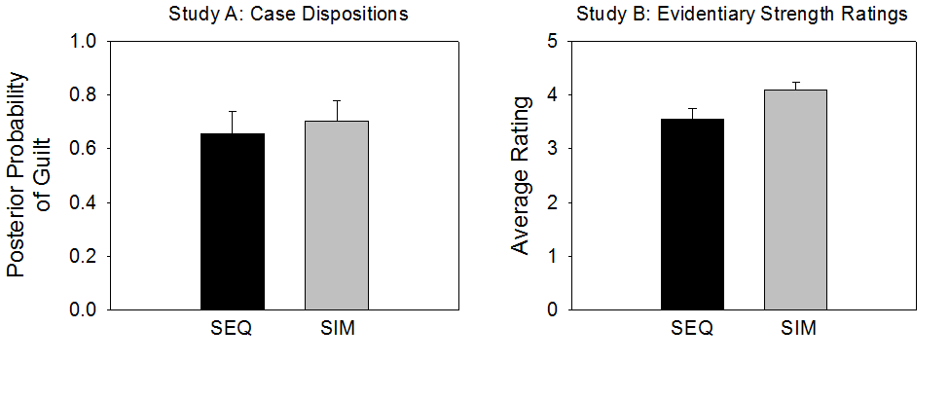
Phase 2 Results
Amendola & Wixted (in press, Journal of Experimental Criminology)
Focus was on guilt or innocence of identified suspects (not on fillers) in the AJS field study
Two measures of “ground truth”:
  Case outcomes (adjudicated guilty or not 1 year later)
  Expert ratings of guilt based on independent evidence in case files
Results:
n.s.
p < .05

Slide 27
.80
.20
.30
.70

Slide 30
Just solve for p (because p is the measure of interest)
p = [pr(Hit) – pr(FA)] / [1 – pr(FA)]
p = (Hit – FA) / (1 – FA)
Standard “correction for guessing”

