Slide 1
Signal-detection theory and receiver operating characteristic (roc) analysis
Psych 272

Slide 2
Eyewitness Memory and
Wrongful Convictions
Since the 1990s, DNA testing has overturned 318 wrongful convictions
Eyewitness misidentifications – which were invariably made with high confidence in a court of law – played a role in 75% of these cases
One of the most famous cases involved the misidentification of a man named Ronald Cotton

Slide 3
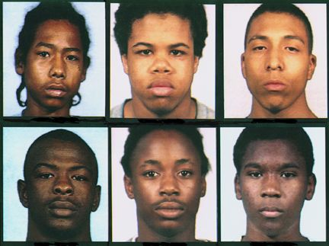
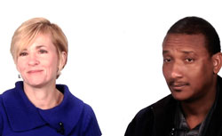
The Case of Ronald Cotton
In 1984, a college student named Jennifer Thompson was raped
Shortly thereafter, she picked Ronald Cotton out of a photo lineup
"I was absolutely, positively, without-a-doubt certain he was the man who raped me when I got on that witness stand and testified against him. And nobody was going to tell me any different."
Cotton was sentenced to life in prison plus 54 years, and he served almost 11 years in jail before being exonerated by DNA testing

Slide 4
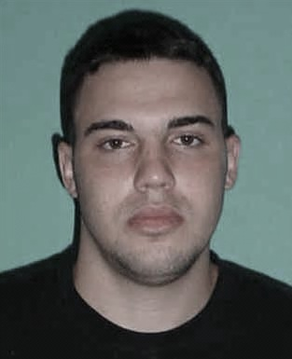
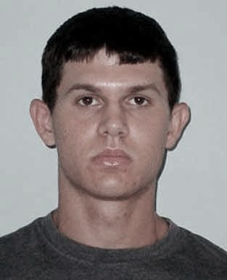
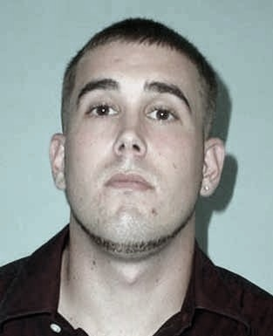
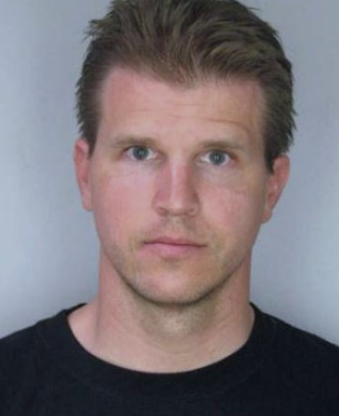
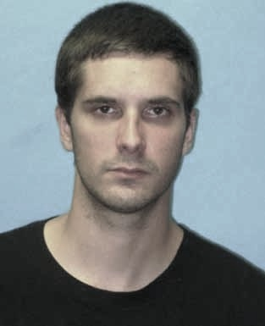

Eyewitness Identification Procedures
Simultaneous Lineup
Suspect:
Innocent or Guilty?
Fillers:
All are known to be innocent

Slide 5
Eyewitness Identification Procedures
Simultaneous Lineup
Sequential Lineup
Suspect:
Innocent or Guilty?

Slide 6
Lindsay & Wells (1985)
Simultaneous lineup
  Correct ID rate = 0.58
  False ID rate = 0.43
Sequential lineup
  Correct ID rate = 0.50
  False ID rate = 0.17
.58 / .43 = 1.35
Diagnosticity Ratio
.50 / .17 = 2.94

Slide 7
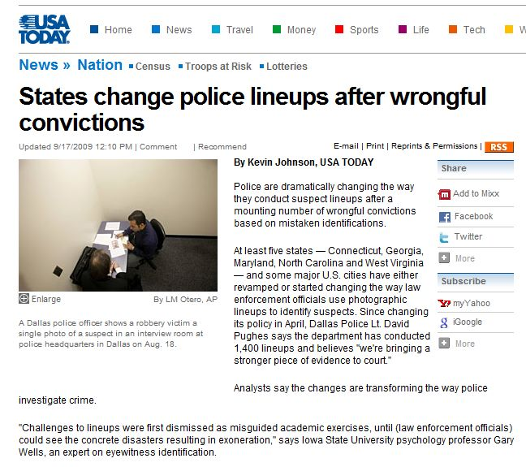

Slide 8
When does signal detection theory apply?
1. There are two true states of the world
  An enemy plane is either present or absent in the sky
  A disease is either present or absent in a patient
  A guilty suspect is either present or absent in a lineup
2. An imperfect diagnostic procedure is used to make a
decision (the target is "present" or "absent")
  An air-defense radar system
  A medical test
  An eyewitness presented with a lineup

Slide 9
2 X 2 Table

Slide 10
2 X 2 Table

Slide 11
2 X 2 Table

Slide 12
2 X 2 Table

Slide 13
2 X 2 Table

Slide 14
2 X 2 Table

Slide 15
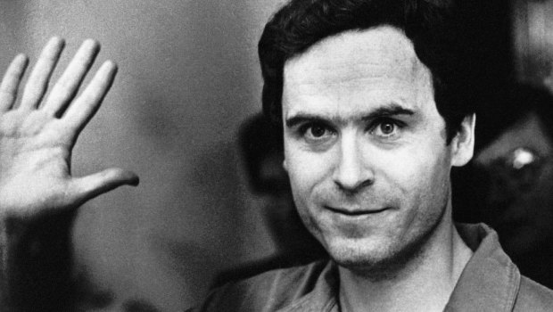
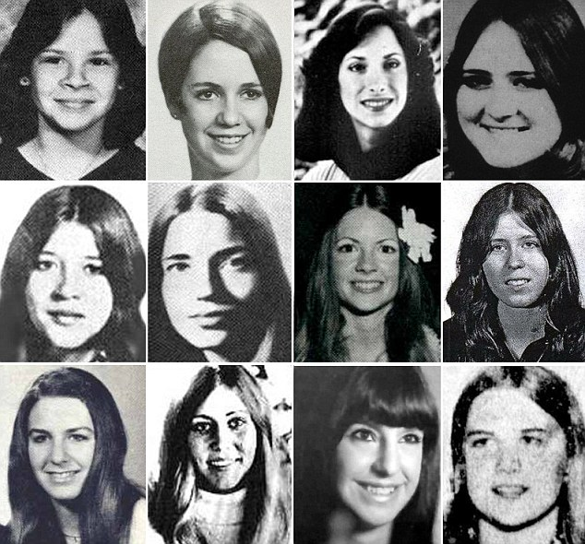
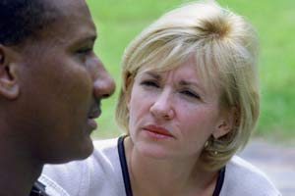
2 X 2 Table
Ted Bundy
Innocence Project
Ronald Cotton

Slide 16
2 X 2 Table
Ted Bundy
Innocence Project
Ronald Cotton

Slide 17
2 X 2 Table

Slide 18
Signal Detection Theory
Continuous diagnostic signal
Power of the reflected radio signal
Blood glucose level
Memory strength

Slide 19
Signal Detection Theory: Response Bias
“the guilty suspect is probably in the lineup”

Slide 20
Signal Detection Theory: Response Bias
“the guilty suspect is probably in the lineup”
“absent”
“present”
Liberal response bias:
Identify even if confidence is low

Slide 21
Signal Detection Theory: Response Bias
“the guilty suspect may or may not be in the lineup”

Slide 22
Signal Detection Theory: Response Bias
“the guilty suspect may or may not be in the lineup”
“absent”
“present”
Neutral response bias:
Identify if confidence is fairly high

Slide 23
Signal Detection Theory: Response Bias
“too many innocent suspects have been misidentified”

Slide 24
Signal Detection Theory: Response Bias
“too many innocent suspects have been misidentified”
“absent”
“present”
Conservative response bias:
Identify only if confidence is very high

Slide 25
Signal Detection Theory: Discriminability

Slide 26
Signal Detection Theory: Discriminability

Slide 27
Signal Detection Theory: Discriminability

Slide 28
Signal Detection Theory: Discriminability

Slide 29
Signal Detection Theory: Discriminability
The degree to which the memory signals associated with innocent and guilty suspects are separated using a particular diagnostic procedure
Discriminability

Slide 30
Liberal
Neutral
Conservative

Slide 31
Liberal: “the guilty suspect is probably in the lineup”

Slide 32
Liberal: “the guilty suspect is probably in the lineup”
Correct ID Rate = 0.98

Slide 33
Liberal: “the guilty suspect is probably in the lineup”
Correct ID Rate = 0.98
False ID Rate = 0.50

Slide 34
Neutral: “the guilty suspect may or may not be the lineup”

Slide 35
Neutral: “the guilty suspect may or may not be the lineup”
Correct ID Rate = 0.84

Slide 36
Neutral: “the guilty suspect may or may not be the lineup”
Correct ID Rate = 0.84
False ID Rate = 0.16

Slide 37
Conservative: “do not make an ID unless you are certain of being correct”

Slide 38
Conservative: “do not make an ID unless you are certain of being correct”
Correct ID Rate = 0.50

Slide 39
Conservative: “do not make an ID unless you are certain of being correct”
Correct ID Rate = 0.50
False ID Rate = 0.02

Slide 40
Correct ID Rate = 0.98
False ID Rate = 0.50
Receiver Operating Characteristic (ROC)
Correct ID Rate = 0.84
False ID Rate = 0.16
Correct ID Rate = 0.50
False ID Rate = 0.02

Slide 41
Receiver Operating Characteristic Analysis
High
discriminability
Low
discriminability

