Slide 1
Signal-detection theory and receiver operating characteristic (roc) analysis
Psych 218 (Week 2)

Slide 2
.80
.20
.30
.70

Slide 3






Eyewitness Identification Procedures
Simultaneous Lineup
Suspect:
Innocent or Guilty?
Fillers:
All are known to be innocent

Slide 4
Eyewitness Identification Procedures
Simultaneous Lineup
Sequential Lineup
Suspect:
Innocent or Guilty?

Slide 5
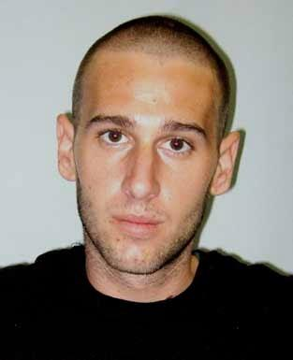
Mock-Crime Laboratory Studies
Each participant (n = 200) first watches a simulated crime
Target-present lineup
(n=100)
Target-absent lineup
(N=100)
Simultaneous Lineup
Simultaneous Lineup

Slide 6
Mock-Crime Laboratory Studies
Each participant (n = 200) first watches a simulated crime
Target-present lineup
(n=100)
Target-absent lineup
(N=100)
Simultaneous Lineup
Simultaneous Lineup

Slide 7
Mock-Crime Laboratory Studies
100 participants tested using a target-present lineup
  Imagine that 58 pick the suspect
  Correct ID rate = .58
100 participants are tested using a target-absent lineup
  Imagine that 43 pick the suspect
  False ID rate = .43

Slide 8
Target-Present Lineup
(Guilty)

Slide 9
Target-Absent Lineup
(Innocent)

Slide 10
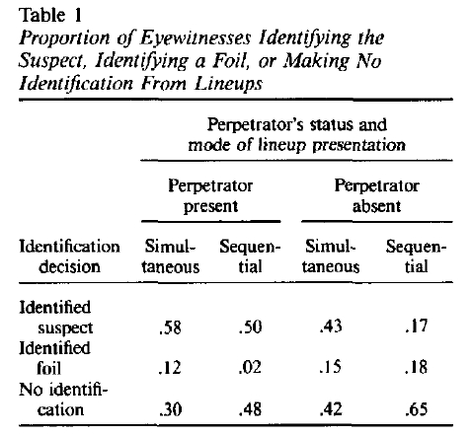
Lindsay & Wells (1985)

Slide 11
Lindsay & Wells (1985)

Slide 12
Lindsay & Wells (1985)
Simultaneous lineup
  Correct Suspect ID rate = 0.58
  False Suspect ID rate = 0.43
Sequential lineup
  Correct Suspect ID rate = 0.50
  False Suspect ID rate = 0.17
.58
——
.43
= 1.35
Diagnosticity Ratio
.50
——
.17
= 2.94

Slide 13
Lindsay & Wells (1985)
Simultaneous lineup
  Correct Suspect ID rate = 0.58
  False Suspect ID rate = 0.43
Sequential lineup
  Correct Suspect ID rate = 0.50
  False Suspect ID rate = 0.17

Slide 14
Lindsay & Wells (1985)
Simultaneous lineup
  Correct Suspect ID rate = 0.58
  False Suspect ID rate = 0.43
Sequential lineup
  Correct Suspect ID rate = 0.50
  False Suspect ID rate = 0.17
1.35
2.94

Slide 15
Correct ID Rate = 0.98
False ID Rate = 0.50
Receiver Operating Characteristic (ROC)
Correct ID Rate = 0.84
False ID Rate = 0.16
Correct ID Rate = 0.50
False ID Rate = 0.02

Slide 16
Varying Response Bias from liberal to conservative

Slide 17
Varying Response Bias from liberal to conservative

Slide 18
Varying Response Bias from liberal to conservative

Slide 19
Varying Response Bias from liberal to conservative

Slide 20
Varying Response Bias from liberal to conservative
Instead of manipulating response bias across conditions to trace out the ROC, you can trace out the same ROC more easily by collecting confidence ratings for each decision.

Slide 21
Target-Present Lineup
(Guilty)

Slide 22
Target-Absent Lineup
(Innocent)

Slide 23
Target-Present Lineup

Slide 24
Target-Present Lineup

Slide 25
Target-Absent Lineup

Slide 26
Target-Absent Lineup

Slide 27
Varying Response Bias from liberal to conservative
≥ 2
≥ 1

Slide 28
Varying Response Bias from liberal to conservative
≥ 3
≥ 2
≥ 1
≥ 4
≥ 5
≥ 6
≥ 7

Slide 29
Varying Response Bias from liberal to conservative
2.28
1.81
1.35
2.94
3.90
5.14
7.2

Slide 30
Varying Response Bias from liberal to conservative

Slide 31
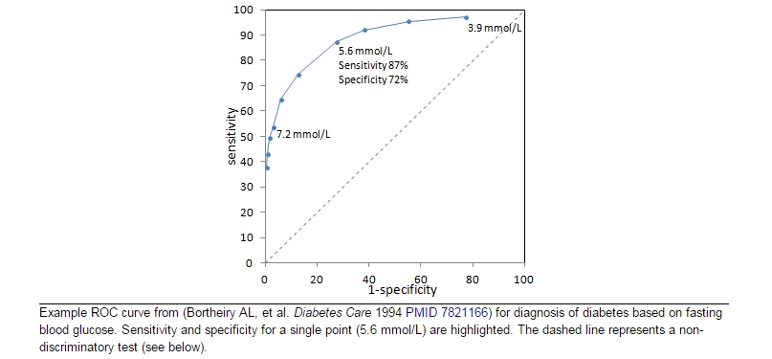
Diabetes
1.25
3.31
16.3

Slide 32
The Concept of Discriminability

Slide 33
The Concept of Discriminability

Slide 34
Lindsay & Wells (1985)
Simultaneous lineup
  Correct Suspect ID rate = 0.58
  False Suspect ID rate = 0.43
Sequential lineup
  Correct Suspect ID rate = 0.50
  False Suspect ID rate = 0.17

Slide 35
Results from ROC Analysis (#1)
Simultaneous vs. Sequential
Mickes, L., Flowe, H. D., & Wixted, J. T. (2012). Journal of Experimental Psychology: Applied, 18, 361–376.

Slide 36
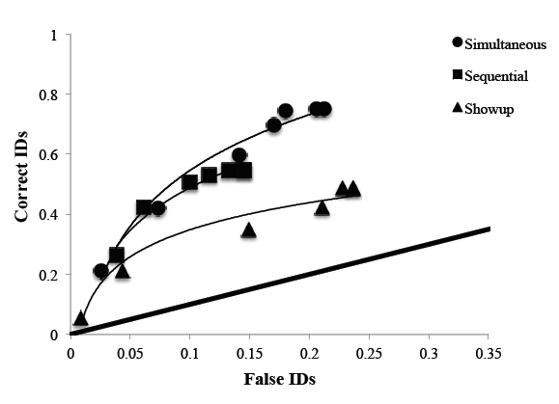
Results from ROC Analysis (#2)
Simultaneous vs. Sequential
SIM
SEQ
Gronlund et al. (2012). Journal of Applied Research in Memory and Cognition, 1, 221–228.

Slide 37
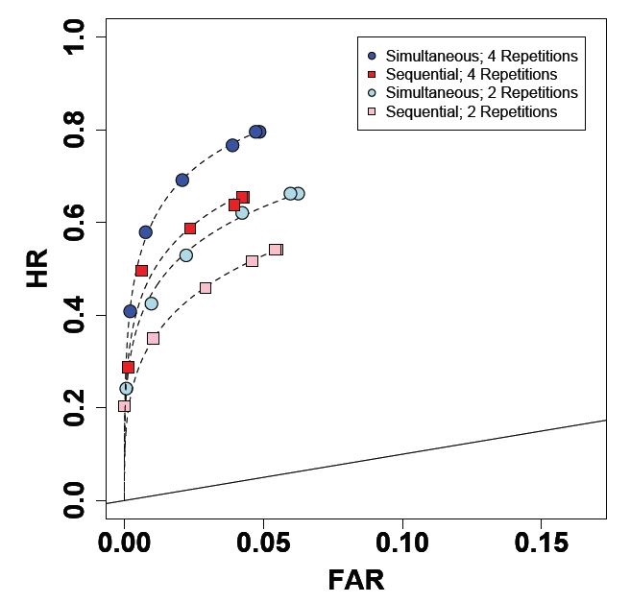
Results from ROC Analysis (#3)
Simultaneous vs. Sequential
SIM x 4
SEQ x 4
SIM x 2
SEQ x 2
Dobolyi, D. G., & Dodson, C. S. (2013). Journal of Experimental Psychology: Applied, 19, 345-357.

Slide 38
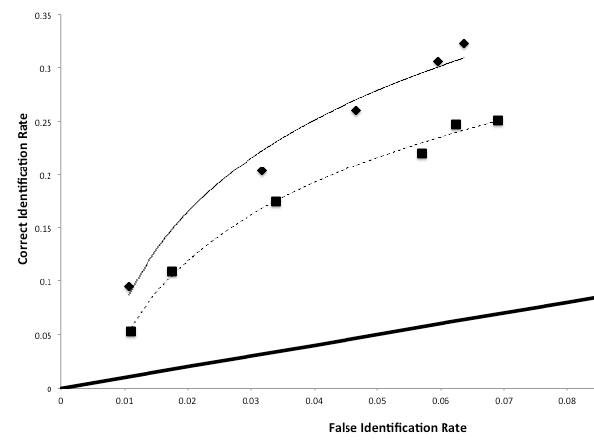
Results from ROC Analysis (#4)
Correct ID Rate
False ID Rate
Carlson, C. A. & Carlson, M. A. (2014). Journal of Applied Research in Memory and Cognition.

Slide 39
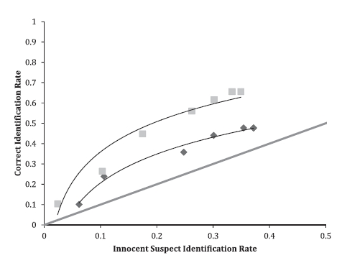
Results from ROC Analysis (#5)
Correct ID Rate
False ID Rate
Andersen, S. M., Carlson, C. A., Carlson, M. A. & Gronlund (2014). Personality and Individual Differences, 60, 36-40.

Slide 40


Slide 41
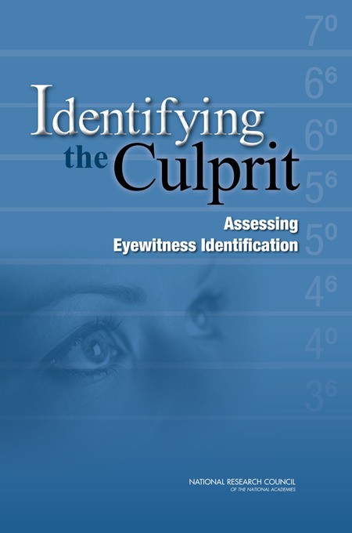

Slide 42
Diagnosticity Ratio or ROC Analysis?
“Despite its merits, a single diagnosticity ratio thus conflates the influences of discriminability and response bias on binary classification, which muddies the determination of which procedure, if any, yields objectively better discriminability in eyewitness performance.”
“Perhaps the greatest practical benefit of recent debate over the utility of different lineup procedures is that it has opened the door to a broader consideration of methods for evaluating and enhancing eyewitness identification performance. ROC analysis is a positive and promising step, with numerous advantages.”
“The committee concludes that there should be no debate about the value of greater discriminability – to promote a lineup procedure that brings less discriminability would be akin to advocating that the lineup be performed in dim instead of bright light.”

Slide 43
What About Recent ROC Analyses?
“…a small set of recent studies using ROC analysis has reported that discriminability (area under the ROC curve) for simultaneous lineups is as high, or higher, than that for sequential lineups.”
“Amendola and Wixted re-analyzed a subset of the data for which proxy measures of ground truth were available…Their analyses suggested that identification of innocent suspects is less likely and identification of guilty suspects is more likely when using the simultaneous procedures. While future studies are needed, these latter findings raise the possibility that diagnosticity is higher for the simultaneous procedures.”

Slide 44
.80
.20
.30
.70

Slide 45
Collect Confidence Ratings
“New” “Old”
------------------------- ------------------------
High Medium Low Low Medium High
1 2 3 4 5 6

Slide 46
Confidence Ratings
1 2 3 4 5 6

Slide 47
1 2 3 4 5 6
1 2 3 4 5 6

Slide 48
1 2 3 4 5 6
1 2 3 4 5 6

Slide 49
.99, .69
.93, .31
.84, .16
.69, .07
.31, .01

Slide 50
Signal Detection Theory
HR = .84
FAR = .16

Slide 51
1 2 3 4 5 6

Slide 52
1 2 3 4 5 6

Slide 53
Signal Detection Theory
HR = .84
FAR = .16
d' is the distance between the two means in standard deviation units
d' = z(HR) - z(FAR)

Slide 55
ROC Analysis
.99, .67
.93, .31
.84, .16
Asymmetrical ROC
.69, .01
.31, .01
Slope ≈ .80

Slide 56
The Unequal-Variance Signal-Detection Model

Slide 57
Likelihood Ratio

Slide 60
Just solve for p (because p is the measure of interest)
p = [pr(Hit) – pr(FA)] / [1 – pr(FA)]
p = (Hit – FA) / (1 – FA)
Standard “correction for guessing”

