Slide 1
Signal-detection theory and receiver operating characteristic (roc) analysis
Psych 218 (Week 1)

Slide 2
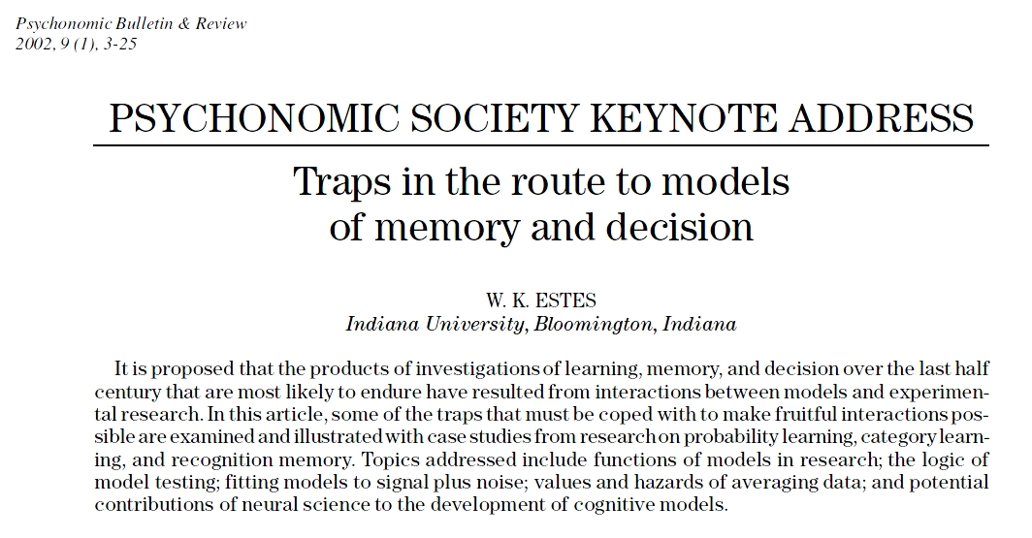

Slide 3
“In the early 1950s, a well-established mathematical theory of statistical decision was used by electrical engineers as the basis for a theory of an ideal detector—that is, a machine that would yield the best possible performance at detecting faint signals in communication networks (W. W. Peterson & Birdsall, 1953).”
“Soon after success of this effort had been demonstrated, an engineer, Wilson P. Tanner, Jr., and a psychologist, John A. Swets, proposed that human performance in perceiving near-threshold stimuli might be described by the signal detection (henceforth, SD) model.”
"Over ensuing decades, the SD model, with only technical modifications to accommodate particular applications, has become almost universally accepted as a theoretical account of decision making in research on perceptual detection and recognition and in numerous extensions to applied domains (Swets, 1988; Swets, Dawes, & Monahan, 2000)."
"This development may well be regarded as the most towering achievement of basic psychological research of the last half century."

Slide 4
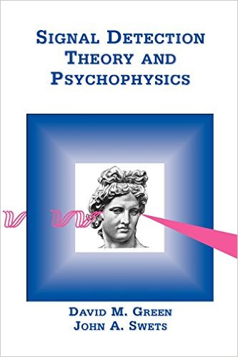
Green & Swets (1966)

Slide 5
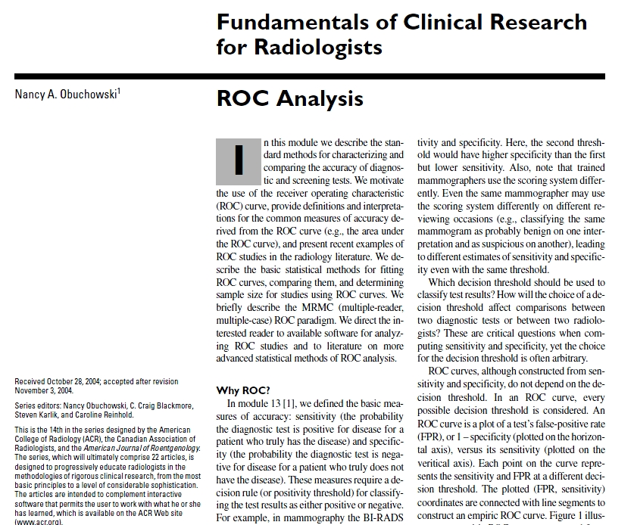

Slide 6
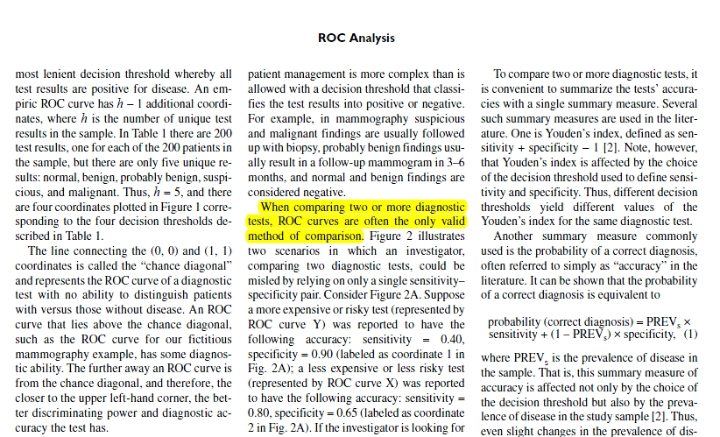

Slide 7
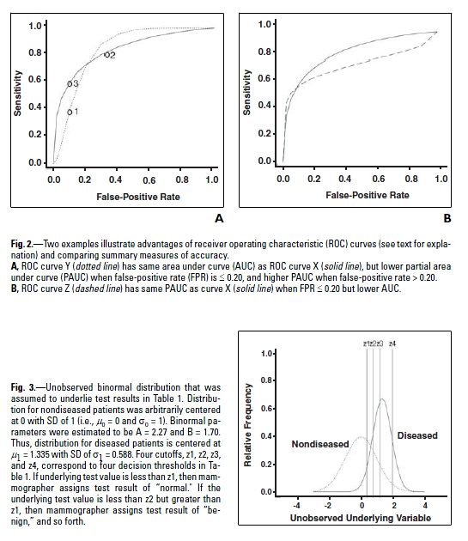

Slide 8
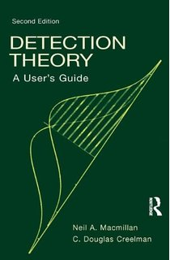
Macmillan & Creelman (2005)

Slide 9
Eyewitness Memory and
Wrongful Convictions
Since the 1990s, DNA testing has overturned 318 wrongful convictions
Eyewitness misidentifications – which were invariably made with high confidence in a court of law – played a role in 75% of these cases
One of the most famous cases involved the misidentification of a man named Ronald Cotton

Slide 10
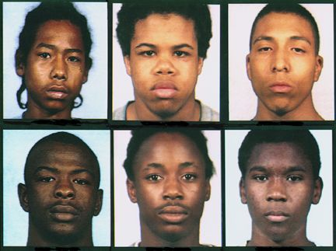
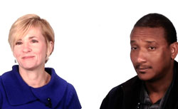
The Case of Ronald Cotton
In 1984, a college student named Jennifer Thompson was raped
Shortly thereafter, she picked Ronald Cotton out of a photo lineup
"I was absolutely, positively, without-a-doubt certain he was the man who raped me when I got on that witness stand and testified against him. And nobody was going to tell me any different."
Cotton was sentenced to life in prison plus 54 years, and he served almost 11 years in jail before being exonerated by DNA testing

Slide 11
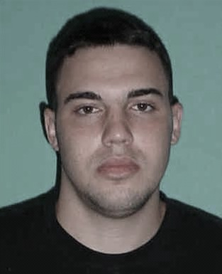
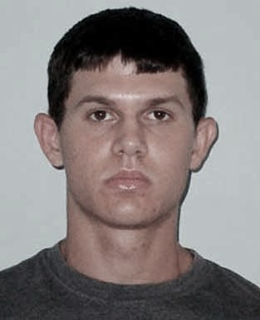
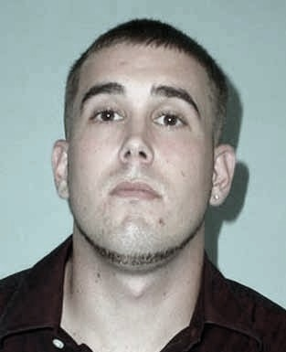

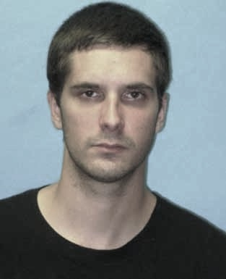

Eyewitness Identification Procedures
Simultaneous Lineup
Suspect:
Innocent or Guilty?
Fillers:
All are known to be innocent

Slide 12
Eyewitness Identification Procedures
Simultaneous Lineup
Sequential Lineup
Suspect:
Innocent or Guilty?

Slide 13
Mock-Crime Laboratory Studies
Each participant (n = 200) watches a simulated crime (e.g., a video of a young man stealing a laptop)
Followed by a lineup memory test:
  Half (n = 100) are then tested using a target-present lineup
  The other half (n = 100) are tested using a target-absent lineup
Advantages and disadvantages
  Main advantage: you know if the suspect is innocent or guilty
  Main disadvantage: lacks the realism of an actual crime

Slide 14
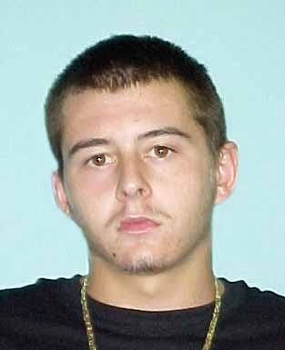
Target-present lineup
(n=100)
Target-absent lineup
(N=100)
Simultaneous Lineup
Simultaneous Lineup

Slide 15
Mock-Crime Laboratory Studies
100 participants tested using a target-present lineup
  Imagine that 58 pick the suspect
  Correct ID rate = .58
100 participants are tested using a target-absent lineup
  Imagine that 43 pick the suspect
  False ID rate = .43

Slide 16
Lindsay & Wells (1985)
Simultaneous lineup
  Correct ID rate = 0.58
  False ID rate = 0.43
Sequential lineup
  Correct ID rate = 0.50
  False ID rate = 0.17
.58
——
.43
= 1.35
Diagnosticity Ratio
.50
——
.17
= 2.94
Diagnosticity ratio = odds that identified suspect is guilty

Slide 17
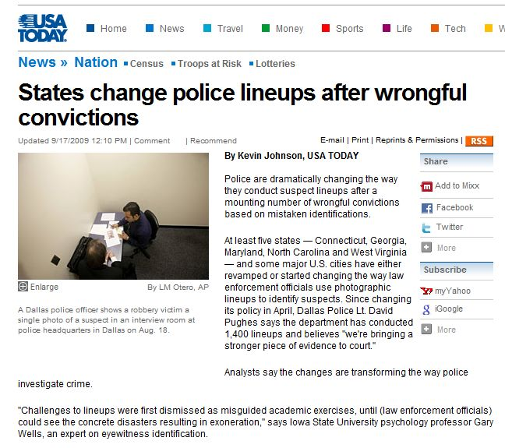

Slide 18
When does signal detection theory apply?
1. There are two true states of the world
  An enemy plane is either present or absent in the sky
  A disease is either present or absent in a patient
  A guilty suspect is either present or absent in a lineup
2. An imperfect diagnostic procedure is used to make a
decision (the target is "present" or "absent")
  An air-defense radar system
  A medical test
  An eyewitness presented with a lineup

Slide 19
2 X 2 Table

Slide 20
2 X 2 Table

Slide 21
2 X 2 Table

Slide 22
2 X 2 Table

Slide 23
2 X 2 Table

Slide 24
2 X 2 Table

Slide 25
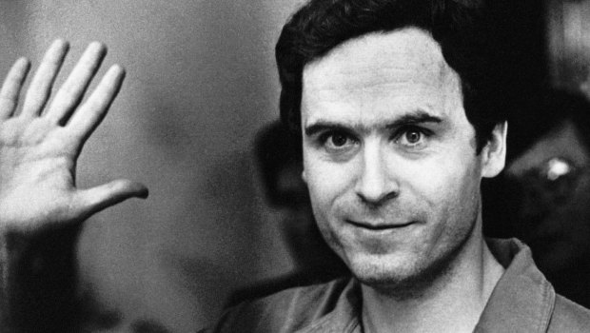
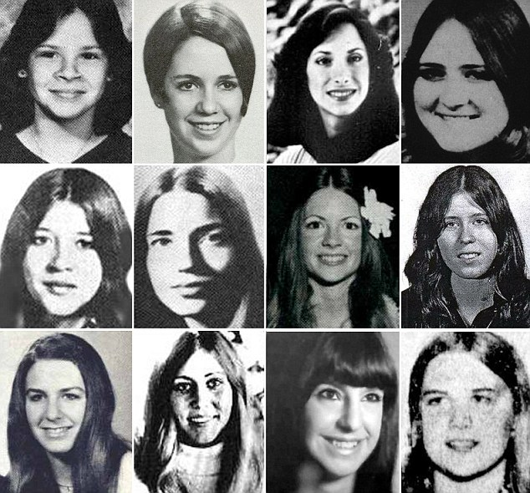
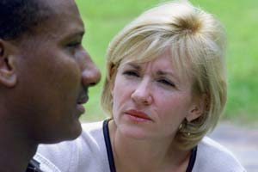
2 X 2 Table
Ted Bundy
Innocence Project
Ronald Cotton

Slide 26
2 X 2 Table
Ted Bundy
Innocence Project
Ronald Cotton

Slide 27
2 X 2 Table
Ted Bundy
Innocence Project
Ronald Cotton

Slide 28
2 X 2 Table

Slide 29
Signal Detection Theory
Continuous diagnostic signal
Power of the reflected radio signal
Blood glucose level
Memory strength

Slide 30
Signal Detection Theory: Response Bias
“the guilty suspect is probably in the lineup”

Slide 31
Signal Detection Theory: Response Bias
“the guilty suspect is probably in the lineup”
“absent”
“present”
Liberal response bias:
Identify even if confidence is low

Slide 32
Signal Detection Theory: Response Bias
“the guilty suspect may or may not be in the lineup”

Slide 33
Signal Detection Theory: Response Bias
“the guilty suspect may or may not be in the lineup”
“absent”
“present”
Neutral response bias:
Identify if confidence is fairly high

Slide 34
Signal Detection Theory: Response Bias
“too many innocent suspects have been misidentified”

Slide 35
Signal Detection Theory: Response Bias
“too many innocent suspects have been misidentified”
“absent”
“present”
Conservative response bias:
Identify only if confidence is very high

Slide 36
Signal Detection Theory: Discriminability
Discriminability is the ability to tell the difference between the two states of the world (e.g., presence or absence of a disease)
The higher discriminability is, the better able you are to correctly classify stimuli into their correct categories

Slide 37
Signal Detection Theory: Discriminability
G
I
G
G
G
I
G
G
I
G
I
G
I
I
I
G
I
I
G
I
G
G
I
G
G
I
I
G
I
G
I
G
I
G
I
I
G
I
I
G
G
G
G
I
I
G
I
I
G
I
I
I
G
G
G
I
I

Slide 38
Signal Detection Theory: Discriminability
G
I
G
G
G
I
G
G
I
G
I
G
I
I
I
G
I
I
G
I
G
G
I
G
G
I
I
G
I
G
I
G
I
G
I
I
G
I
I
G
I
G
G
G
I
I
I
G
I
G
I
G
I
I
G
G
I
I
G
G
I
G
G
I
I
G
I
I
G
G
G
I
I
G
G
G
I
I
I
G

Slide 39
Signal Detection Theory: Discriminability

Slide 40
Signal Detection Theory: Discriminability

Slide 41
Signal Detection Theory: Discriminability

Slide 42
Signal Detection Theory: Discriminability

Slide 43
Signal Detection Theory: Discriminability
The degree to which the memory signals associated with innocent and guilty suspects are separated using a particular diagnostic procedure
Discriminability

Slide 44
Liberal
Neutral
Conservative

Slide 45
Liberal: “the guilty suspect is probably in the lineup”

Slide 46
Liberal: “the guilty suspect is probably in the lineup”
Correct ID Rate = 0.98

Slide 47
Liberal: “the guilty suspect is probably in the lineup”
Correct ID Rate = 0.98
False ID Rate = 0.50

Slide 48
Neutral: “the guilty suspect may or may not be the lineup”

Slide 49
Neutral: “the guilty suspect may or may not be the lineup”
Correct ID Rate = 0.84

Slide 50
Neutral: “the guilty suspect may or may not be the lineup”
Correct ID Rate = 0.84
False ID Rate = 0.16

Slide 51
Conservative: “do not make an ID unless you are certain of being correct”

Slide 52
Conservative: “do not make an ID unless you are certain of being correct”
Correct ID Rate = 0.50

Slide 53
Conservative: “do not make an ID unless you are certain of being correct”
Correct ID Rate = 0.50
False ID Rate = 0.02

Slide 54
Correct ID Rate = 0.98
False ID Rate = 0.50
Receiver Operating Characteristic (ROC)
Correct ID Rate = 0.84
False ID Rate = 0.16
Correct ID Rate = 0.50
False ID Rate = 0.02

Slide 55
Receiver Operating Characteristic Analysis
High
discriminability
Low
discriminability

